Slide 1
STS Global Test Data Management
NI STS Test Program Development Best Practice
Matthew Roberts
NI Senior Field Applications Engineer

Slide 2
Glossary & Resources
STS Global Test Data Management
Abbreviated Terminology
TS – TestStand
TSM – TestStand Semiconductor Module
STS – Semiconductor Test System
LV – LabVIEW
Lot – The queue of devices under test that are ran sequentially or as a batch across multiple test sites during a production run.
ProcessSetup – Callback in TestStand used to define steps that execute when a Lot starts
Resources/Assumed-knowledge
Test Program Development with STS and LabVIEW Course - https://www.ni.com/en-gb/shop/services/education-services/customer-education-courses/test-program-development-with-sts-and-labview.html
LabVIEW Object Oriented - https://www.ni.com/docs/en-US/bundle/labview/page/lvconcepts/front_oolv.html
LabVIEW Property Nodes - https://www.ni.com/docs/en-US/bundle/labview/page/glang/property_node.html
TSM Data Management - https://www.ni.com/docs/en-US/bundle/teststand-2020-semiconductor-module/page/tssemiconductor/tsmdatamanagement.html
TSM Sharing Data Between Code Modules - https://www.ni.com/docs/en-US/bundle/teststand-2020-semiconductor-module/page/tssemiconductor/tsm_sharingdatabetweencodemodules.html

Slide 3
Overview
STS Global Test Data Management
Problem Statement
Overview of the TSM Data Access Technique
Pros & Cons of the TSM Data Access Technique
Workflows
Adding Global Test Data to Existing Project
Creating A New Property
Using Global Test Data Properties in Code Modules
Initializing Global Test Data in ProcessSetup
Taking this concept to the next level!

Slide 4
Problem Statement
STS Global Test Data Management
Status Quo
When developing an NI STS Test Program certain data will typically be stored in one code module and retrieved later in another code module.
Such data can and should be stored in the SemiconductorModuleContext (TSM Context) using an ID string and can either be stored as a single data value available globally to all sites or as a data value per site.
When developing with LabVIEW (LV), this is done using the Set Global Data VI and the Get Global Data VI when storing and retrieving data shared by all sites. Or using the Set Site Data VI and the Get Site Data VI to storing and retrieving site specific data.
Refer to the following NI STS Help Documentation: https://www.ni.com/docs/en-US/bundle/teststand-2020-semiconductor-module/page/tssemiconductor/tsm_sharingdatabetweencodemodules.html
Problem Statement
The LV API functions for storing and retrieving data within the TSM Context…
rely on ID strings that test developers can easily mistype and must ensure are consistent across code modules. In practice, this can be hard to manage and debug.
are type agnostic and require the test developer to micromanage when retrieving the data. In practice, it can be difficult to keep track of what data type is associated with the string ID being retrieved, and this casting from variant data to the desired data type adds clutter to the block diagram, especially in the per-site use case.
Important Note
Sharing data between modules → While there are other, LabVIEW native mechanicians for storing the same type of data, none provide the convivence and robustness of using the TSM Context when it comes to managing site data. All other mechanisms require the test developer to micromanage the order of the site data, and whether certain sites are inactive (site goes down mid lot) or not being called from within the code module’s context (independent code module execution per site or group of sites).
Notes:
Notes
Where is the actual data being stored? → TSM memory space, not LabVIEW memory space
Sharing data between modules → While there are other, LabVIEW native, mechanicians for storing the same type of data, none provide the convivence and robustness of using the SemiconductorModuleContext when it comes to managing site data. All other mechanisms require the test developer to micromanage the order of the site data, and whether certain sites are inactive (site goes down mid lot) or not being called from within the code module’s context (independent code module execution per site or group of sites).

Slide 5
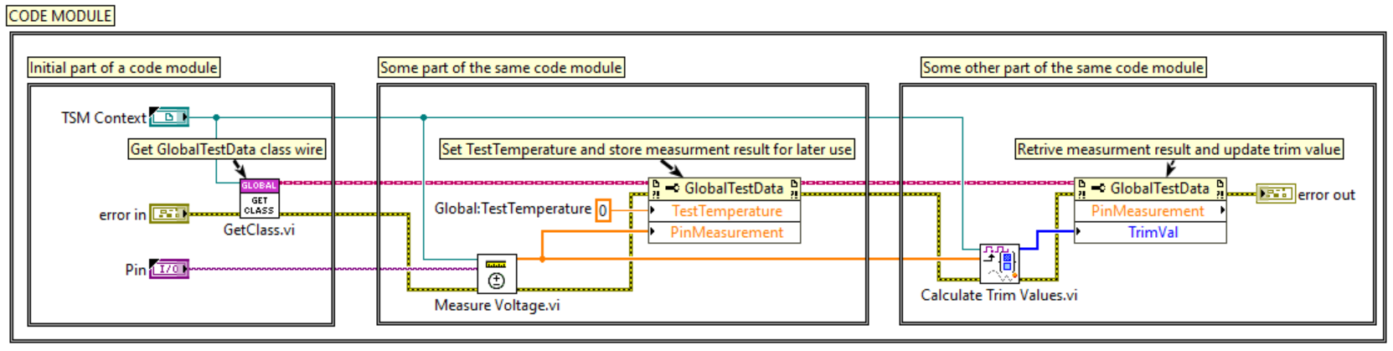
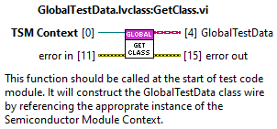
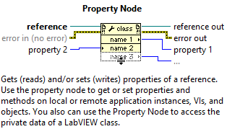
Overview of the TSM Data Access Concept
STS Global Test Data Management
TSM Data Access Concept
Utilizes LabVIEW Class Behavior for Convenient Test Program Data Storage, Access, & Management
Compares of flat LabVIEW class with a pre-defined set of properties
Read & Write accessor functions created for each individual data item being stored
Read & Write accessor strictly defines the data item’s data type (i.e. i32 vs String)
The data item can be any LabVIEW native data type, including enums and custom type-definitions*
Uses Semiconductor Module Context & corresponding API as the means for memory storage
Inherently Global & Per-Site Capable
Extracts data types & sites management away from the users
Only two LabVIEW nodes used during test program development
Get Class.vi ← Encapsulates the TSM context into an LV class wire that can be accessed via property node
Property Nodes ← Used to invoke pre-defined read/write accessor functions for a given data item defined in the class
Scalable to add as many data items as needed throughout the development process
Important Notes
Where is the actual data being stored?
Data is stored by reference in TSM’s memory space (dynamic memory within TSM’s .NET assembly), it is not actually being stored in LabVIEW’s memory space.
The class wire is essentially a wrapped reference to the TSM context, when you operate on a data item via property node the property node will call in the TSM context’s memory space to access the data item.
Although you are passing the data by value on the LabVIEW block diagram, the accessing of the data happens by reference… that is the reference to the TSM context.
Property Node elements are executed on sequentially, which means whichever order you read or write from, top-->down, would be the order in which the data would be manipulated.
This inherently prevents any race conditions within a certain VI if there is only ever one Property Node accessing the class at a given time.
Since the wire is passing around and operating on the data by reference behind the scenes, you should still incorporate data flow where possible to ensure two property nodes are not being used at the same time, where one can just as easily do the job. Avoid using branching the same Class wire to multiple Property Nodes unless you can ensure those Property Nodes are accessing unique data items. Otherwise, access all necessary data items for a particular part of your code module using one Property node at a time.
Lifetime of Get Class wire reference: Class wire inherently same context as the TSM context, and therefore this VI must be called in every test code module that intends to access a data item.
The intended use case for a given VI is to only ever need to call the “GetClass.vi" function once, to get the class wire and then use the class wire as a reference to access the data via property node and connect the wire to the next instance of property node which access the data.
Data Types: Data items can be of any LabVIEW type, including Enums & Type Definitions.
*If the data type you want to store is a type def, the .ctl file for the type def should exist within the ...\Code Module\Common\<TSM Context Data Access Class Name>\Public\Typedefs directory.
Notes:
Important Notes
Where is the actual data being stored?
Data is stored by reference in TSM’s memory space (dynamic memory within TSM’s .NET assembly), it is not actually being stored in LabVIEW’s memory space.
The class wire is essentially a wrapped reference to the TSM context, when you operate on a data item via property node the property node will call in the TSM context’s memory space to access the data item.
Although you are passing the data by value on the LabVIEW block diagram, the accessing of the data happens by reference… that is the reference to the TSM context.
Property Node elements are executed on sequentially, which means whichever order you read or write from, top-->down, would be the order in which the data would be manipulated.
This inherently prevents any race conditions within a certain VI if there is only ever one Property Node accessing the class at a given time.
Since the wire is passing around and operating on the data by reference behind the scenes, you should still incorporate data flow where possible to ensure two property nodes are not being used at the same time, where one can just as easily do the job. Avoid using branching the same Class wire to multiple Property Nodes unless you can ensure those Property Nodes are accessing unique data items. Otherwise, access all necessary data items for a particular part of your code module using one Property node at a time.
Lifetime of Get Class wire reference: Class wire inherently same context as the TSM context, and therefore this VI must be called in every test code module that intends to access a data item.
The intended use case for a given VI is to only ever need to call the “GetClass.vi" function once, to get the class wire and then use the class wire as a reference to access the data via property node and connect the wire to the next instance of property node which access the data.
Data Types: Data items can be of any LabVIEW type, including Enums & Type Definitions.
*If the data type you want to store is a type def, the .ctl file for the type def should exist within the ...\Code Module\Common\<TSM Context Data Access Class Name>\Public\Typedefs directory.

Slide 6
Pros & Cons of the TSM Data Access Technique
STS Global Test Data Management
Pros
Only two LabVIEW nodes are needed during test code module development to store & retrieve data
Declutters & simplifies the block diagram, especially when storing/retrieving multiple data items
Abstracts management of site-base data away from the test developer
Eliminates the need to manage data types during test code module development
Properties are strictly typed and do not require the test developer to cast data type when retrieving a data item
Ensures the storage and retrieval of data is consistent across code modules
ID strings are abstracted from the test developer, eliminating the possibility that they can be mistyped.
Cons
Separate files (read & write) on disk for each data property defined for the test program.
Test developer must create a data property as needed and update the data type upon its creation.
LabVIEW’s VI scripting feature helps with this burden.
Storing/retrieving multiple data items is not optimized when called from same property node, due to how property node items sequentially execute. Test developers must use multiple property nodes to gain parallel execution.
Because data is being stored in TSM context, there is some amount of overhead when calling into TSM to store and retrieve the data.

Slide 7
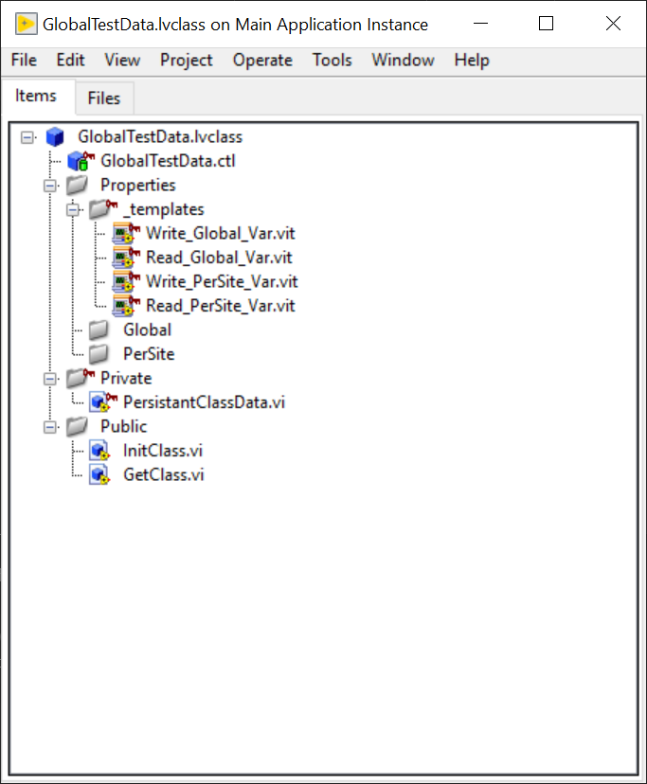
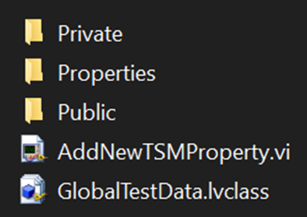
Global Test Data Template Files
STS Global Test Data Management
Template files available on GitHub:
https://github.com/Mattjet27/STSGlobalTestDataTemplate
Includes:
GlobalTestData LabVIEW class
Property VI Templates - Global & PerSite
AddNewTSMPropery.vi - scripts new properties and adds them to the GlobalTestData class automatically based on the name and scope specified by front panel controls.
Note: these templates files can but should not be modified.

Slide 8
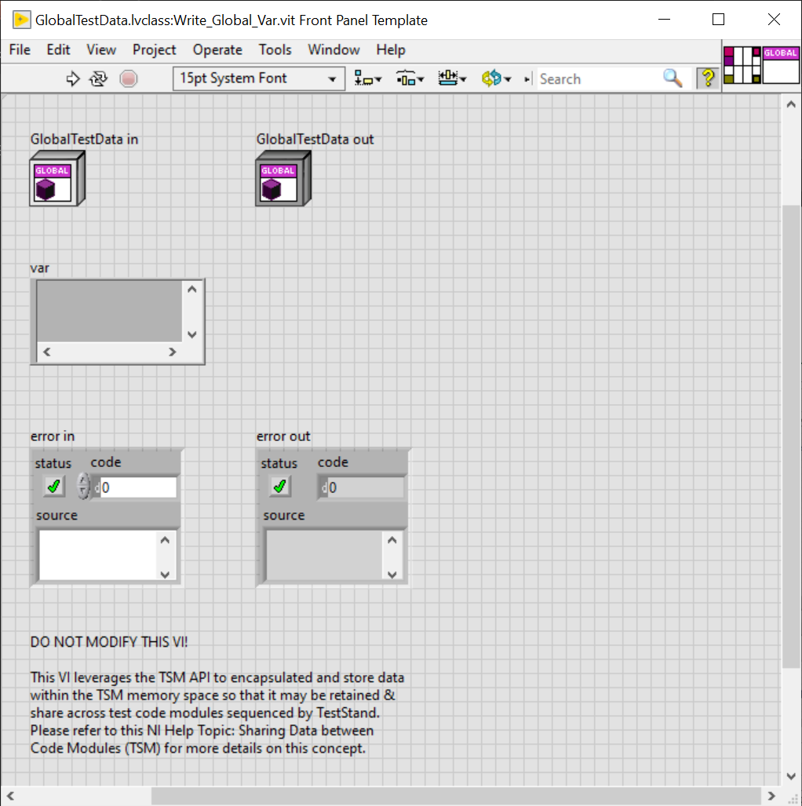
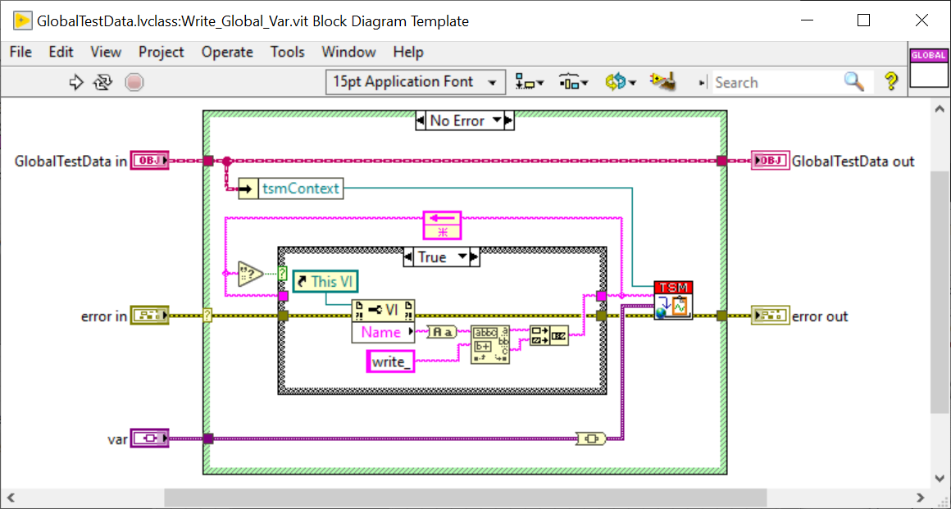
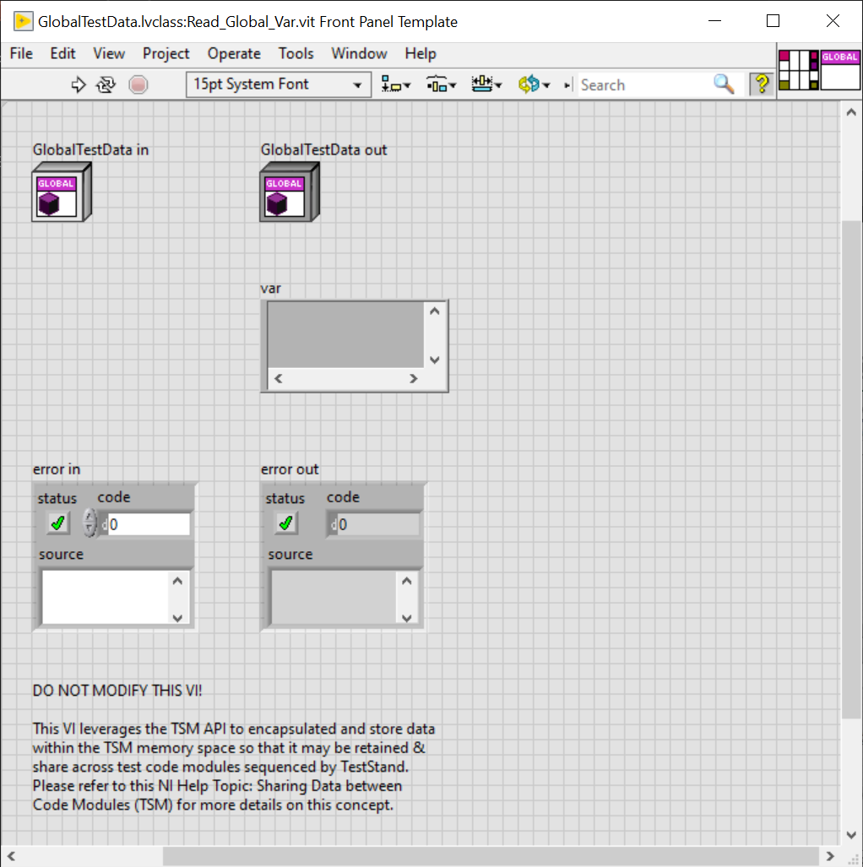
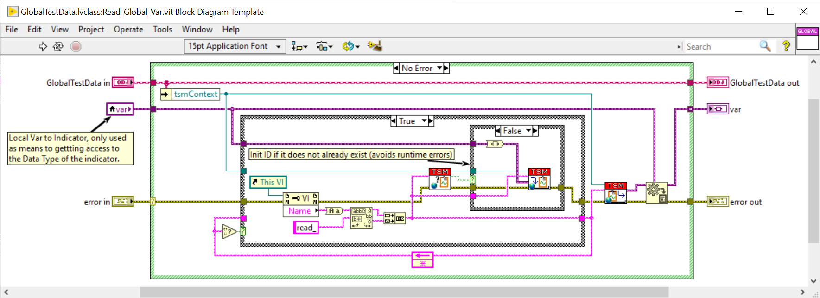
Read/Write Template VI - Global
STS Global Test Data Management

Slide 9
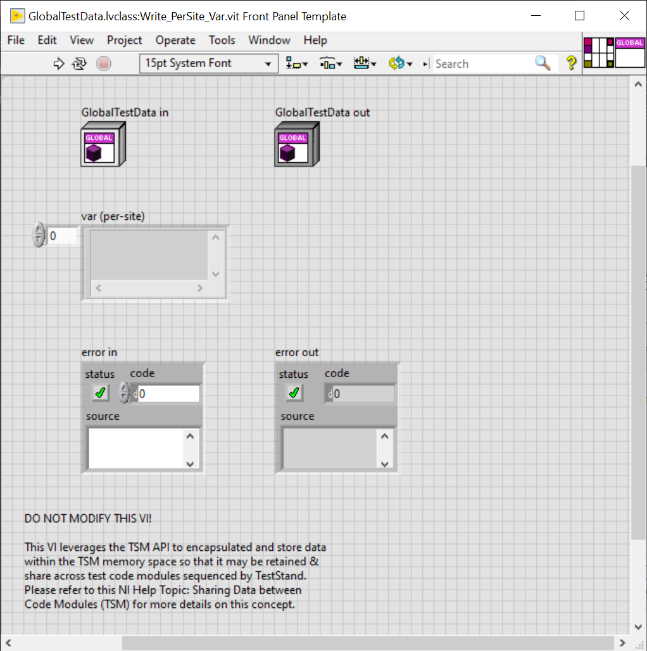
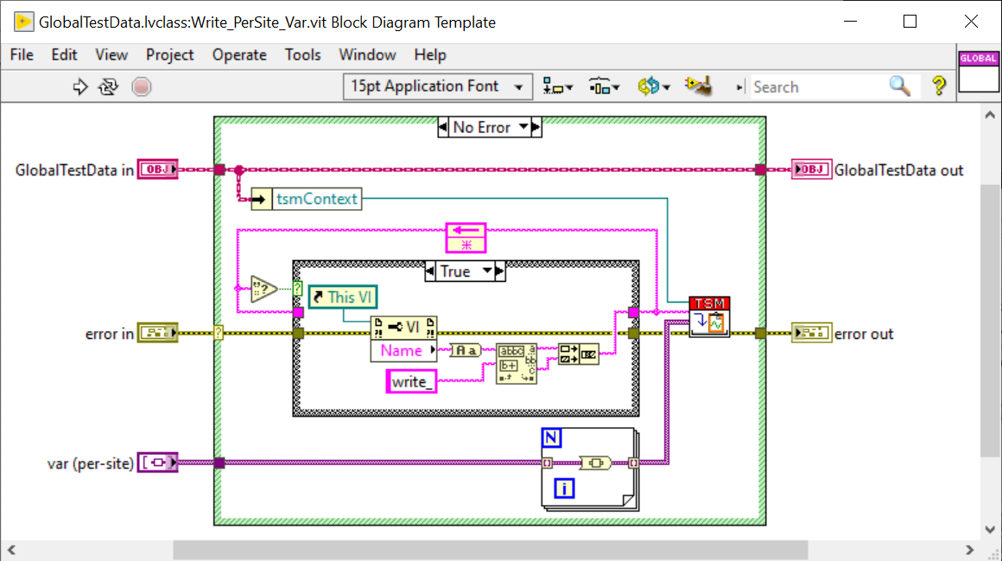
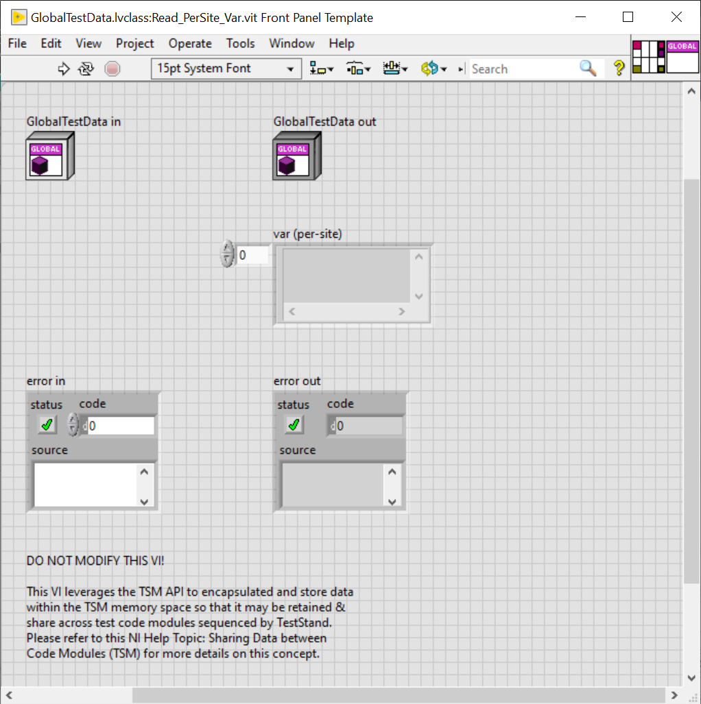
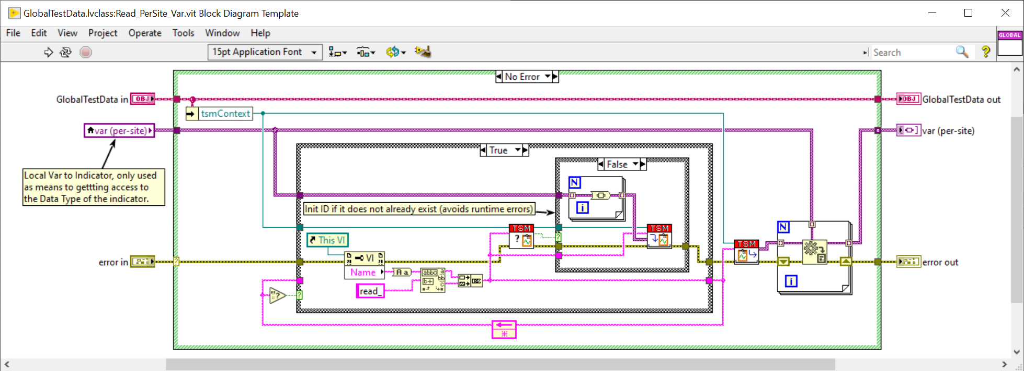
Read/Write Template VI - PerSite
STS Global Test Data Management

Slide 10
Workflow – Adding Global Test Data to Existing Project
STS Global Test Data Management
Download the Global Test Data template files from GitHub
Copy or move the GlobalTestData directory into the Code Modules/Common directory of your test program’s source
Ensure Code Modules/Common/GlobalTestData has been added to the LabVIEW project
Define & add new application specific properties to the Global Test Data class
Create both a Read & Write VI for each new property.
Refer to proceeding slides labeled: “Workflow – Creating A New Property slides”
Repeat as needed to scale during test program development
Notes:
https://github.com/Mattjet27/STSGlobalTestDataTemplate

Slide 11
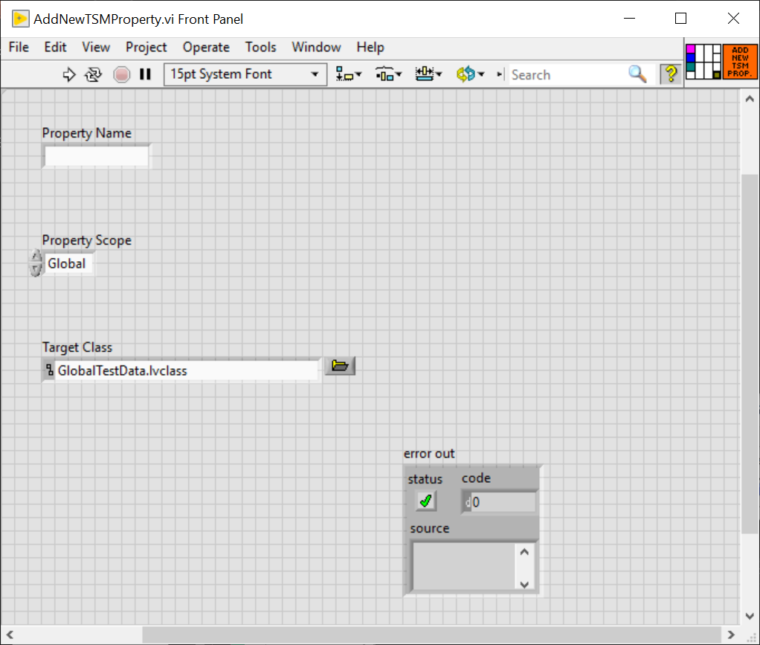
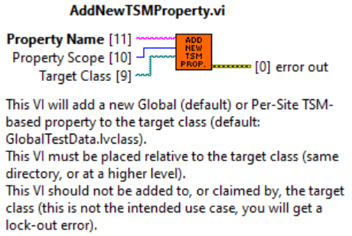
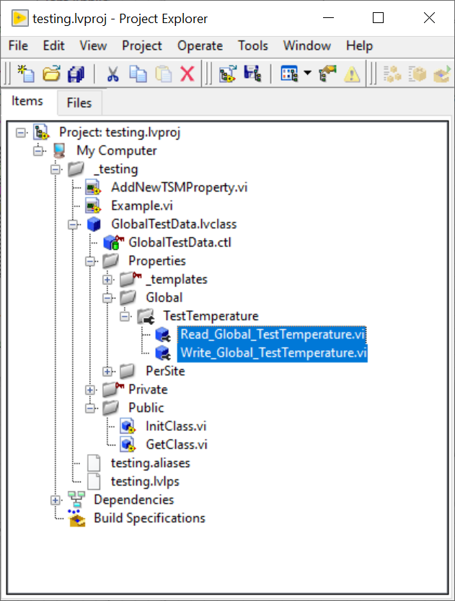
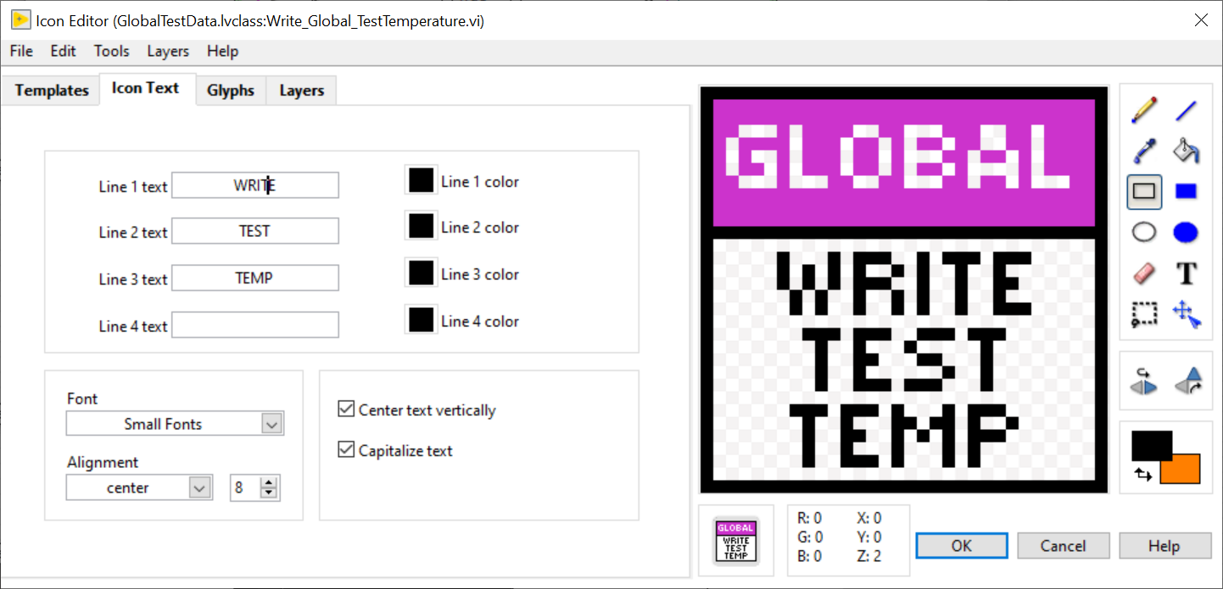
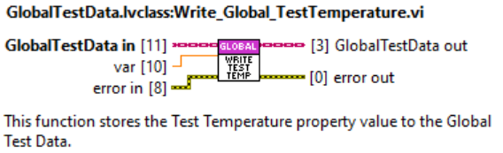
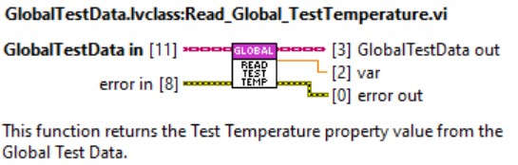
Workflow – Creating A New Property (Scripted Method)
STS Global Test Data Management
Open the AddNewTSMProperty.vi
Input the desired property name into the Property Name control
Select either Global or PerSite from the Property Scope control to set the property’s scope.
Global scope – single value at runtime for all sites (site agnostic).
PerSite scope – separate values at runtime for each site defined by pin map (site unique)
Run the AddNewTSMProperty VI
After the VI finishes executing, locate the newly created properties from within the LabVIEW Project Explore window
Open both the Write_<scope>_<name>.vi & Read_<scope>_<name>.vi modify the following:
Right click the variant control/indicator (make sure to hover over just the element if scope is PerSite) and select replace, then choose the appropriate data type for the property.
Note that the data type must match between both VIs or the run arrow for both VIs will be broken.
Update the VI Icon of both functions to match the property name. For example, if the property name is TestTemperature see example below
Edit the VI Properties to add documentation to each VI as well.

Slide 12
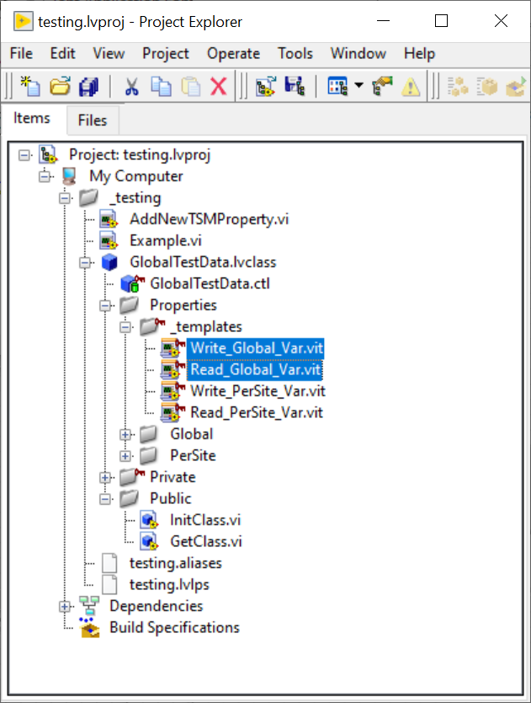
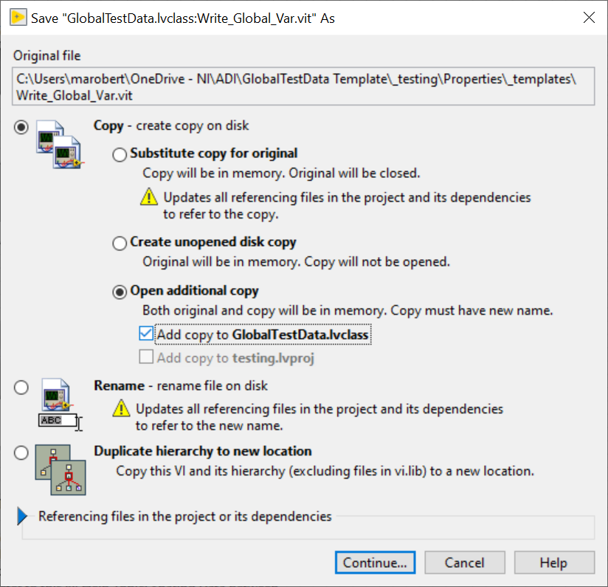
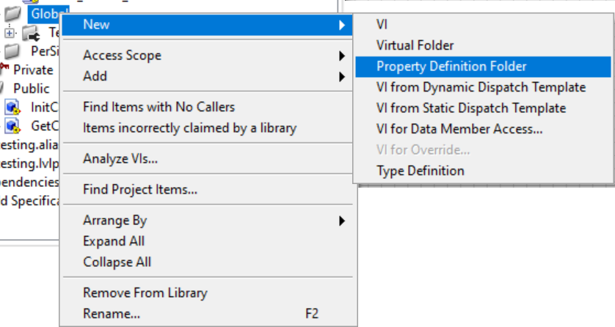
Workflow – Creating A New Property (Manual Method)
STS Global Test Data Management
Locate the _templates private virtual folder of the GlobalTestData.lvclass from within the LabVIEW Project Explore window
Open the appropriate Write template file for the desired scope (Global or PerSite) and then Save As with the Open additional copy: Add copy to GlobalTestData.class option selected.
Global scope – single value at runtime for all sites (site agnostic).
PerSite scope – separate values at runtime for each site defined by pin map (site unique)
Save the new Write VI with the following file naming convention and save it to the GlobalTestData/Properties directory on disk: Write_<scope>_<name>.vi
Repeat steps 2 & 3 with the Read template file, naming the copy Read_<scope>_<name>.vi
From within the LabVIEW Project Explore window, locate and expand the Properties virtual folder of the GlobalTestData.lvclass and right click the appropriate virtual folder for the scope selected (Global or PerSite) and choose New→Property Definition Folder
Rename the newly created Property Definition Folder to the name you have chosen for the new property.
From within the LabVIEW Project Explore window, move the both the Write_<scope>_<name>.vi & Read_<scope>_<name>.vi files you created in steps 2-4 into the newly created Property Definition Folder.
Open both the Write_<scope>_<name>.vi & Read_<scope>_<name>.vi modify the following:
Right click the variant control/indicator (make sure to hover over just the element if scope is PerSite) and select replace, then choose the appropriate data type for the property.
Note that the data type must match between both VIs or the run arrow for both VIs will be broken.
Update the VI Icon of both functions to match the property name. For example, if the property name is TestTemperature see example below
Edit the VI Properties to add documentation to each VI as well.

Slide 13
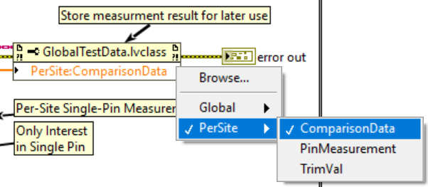
Workflow – Using Global Test Data Properties in Code Modules
STS Global Test Data Management
Accessing Data During Code Module Development
Drop down the GlobalTestData.lvclass:Get Class.vi onto the block diagram of your code module and wire the Semiconductor Module context to its top input terminal (TSM Context).
Drop down a LabVIEW Property Node (any type) and wire the GlobalTestData class wire from the Get Class from TSM Context.vi’s output terminal to the Property Node’s input terminal.
Make sure to also wire up the error wires appropriately.
Click to select the items to access within the property node and drag the bottom of the property node to expand out the number of items to be accessed.
Note: right clicking the item within the property node will allow you to change whether to read or right to that property, it will read by default unless changed. It will also give you an option to open the accessor function if it needs to be reviewed or modified.
Notes:
Important Notes
Where is the actual data being stored?
Data is stored by reference in TSM’s memory space (dynamic memory within TSM’s .NET assembly), it is not actually being stored in LabVIEW’s memory space.
The class wire is essentially a wrapped reference to the TSM context, when you operate on a data item via property node the property node will call in the TSM context’s memory space to access the data item.
Although you are passing the data by value on the LabVIEW block diagram, the accessing of the data happens by reference… that is the reference to the TSM context.
Property Node elements are executed on sequentially, which means whichever order you read or write from, top-->down, would be the order in which the data would be manipulated.
This inherently prevents any race conditions within a certain VI if there is only ever one Property Node accessing the class at a given time.
Since the wire is passing around and operating on the data by reference behind the scenes, you should still incorporate data flow where possible to ensure two property nodes are not being used at the same time, where one can just as easily do the job. Avoid using branching the same Class wire to multiple Property Nodes unless you can ensure those Property Nodes are accessing unique data items. Otherwise, access all necessary data items for a particular part of your code module using one Property node at a time.
Lifetime of Get Class wire reference: Class wire inherently same context as the TSM context, and therefore this VI must be called in every test code module that intends to access a data item.
The intended use case for a given VI is to only ever need to call the “GetClass.vi" function once, to get the class wire and then use the class wire as a reference to access the data via property node and connect the wire to the next instance of property node which access the data.
Data Types: Data items can be of any LabVIEW type, including Enums & Type Definitions.
*If the data type you want to store is a type def, the .ctl file for the type def should exist within the ...\Code Module\Common\<TSM Context Data Access Class Name>\Public\Typedefs directory.

Slide 14
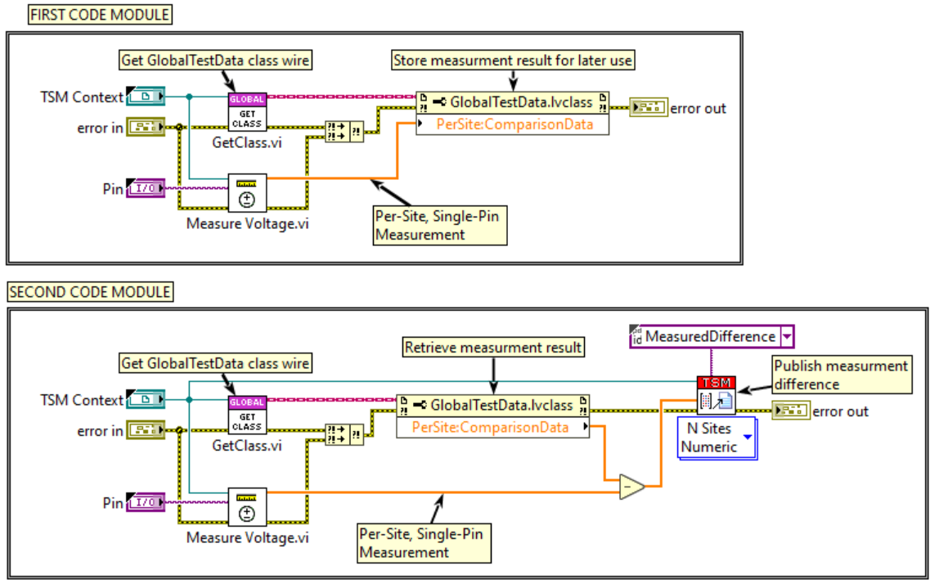
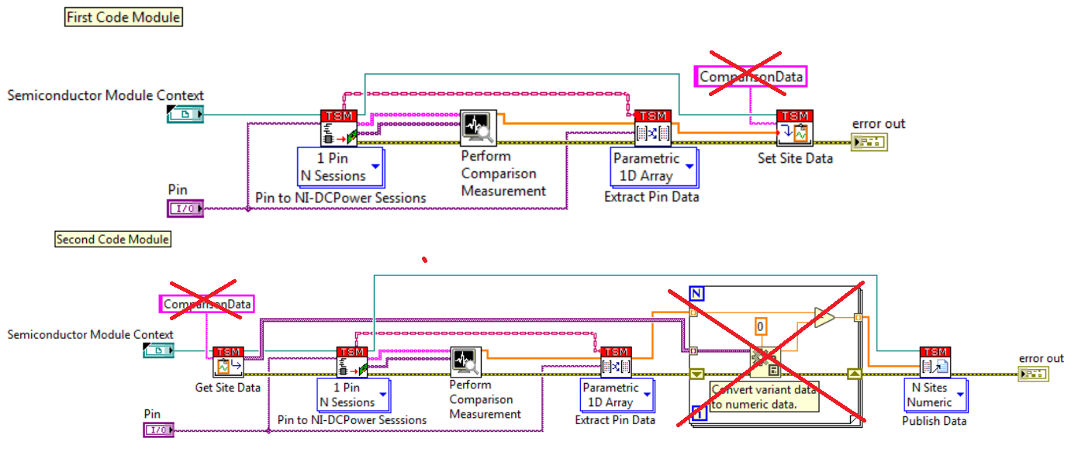
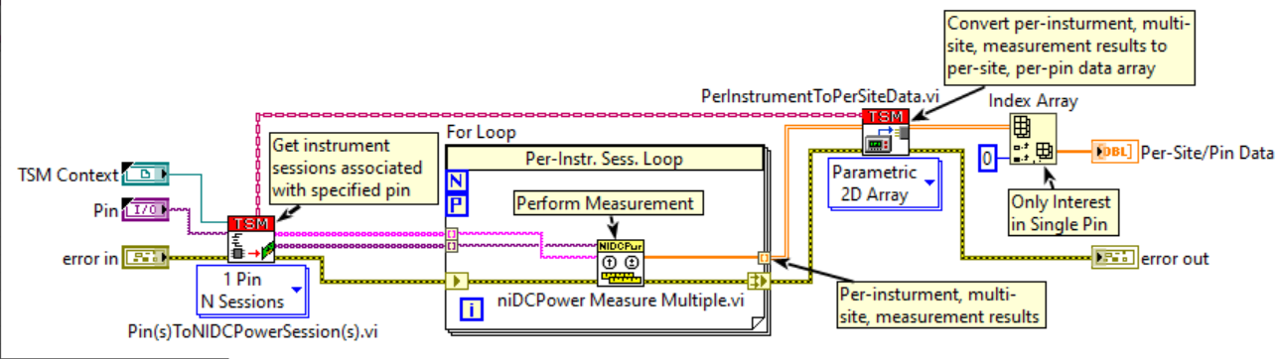
Example – Sharing Global Test Data Between Code Modules
STS Global Test Data Management
With Native TSM Solution
With TSM Context Data Access Concept
Measure Voltage.vi
Notes:
Important Notes
Where is the actual data being stored?
Data is stored by reference in TSM’s memory space (dynamic memory within TSM’s .NET assembly), it is not actually being stored in LabVIEW’s memory space.
The class wire is essentially a wrapped reference to the TSM context, when you operate on a data item via property node the property node will call in the TSM context’s memory space to access the data item.
Although you are passing the data by value on the LabVIEW block diagram, the accessing of the data happens by reference… that is the reference to the TSM context.
Property Node elements are executed on sequentially, which means whichever order you read or write from, top-->down, would be the order in which the data would be manipulated.
This inherently prevents any race conditions within a certain VI if there is only ever one Property Node accessing the class at a given time.
Since the wire is passing around and operating on the data by reference behind the scenes, you should still incorporate data flow where possible to ensure two property nodes are not being used at the same time, where one can just as easily do the job. Avoid using branching the same Class wire to multiple Property Nodes unless you can ensure those Property Nodes are accessing unique data items. Otherwise, access all necessary data items for a particular part of your code module using one Property node at a time.
Lifetime of Get Class wire reference: Class wire inherently same context as the TSM context, and therefore this VI must be called in every test code module that intends to access a data item.
The intended use case for a given VI is to only ever need to call the “GetClass.vi" function once, to get the class wire and then use the class wire as a reference to access the data via property node and connect the wire to the next instance of property node which access the data.
Data Types: Data items can be of any LabVIEW type, including Enums & Type Definitions.
*If the data type you want to store is a type def, the .ctl file for the type def should exist within the ...\Code Module\Common\<TSM Context Data Access Class Name>\Public\Typedefs directory.

Slide 15
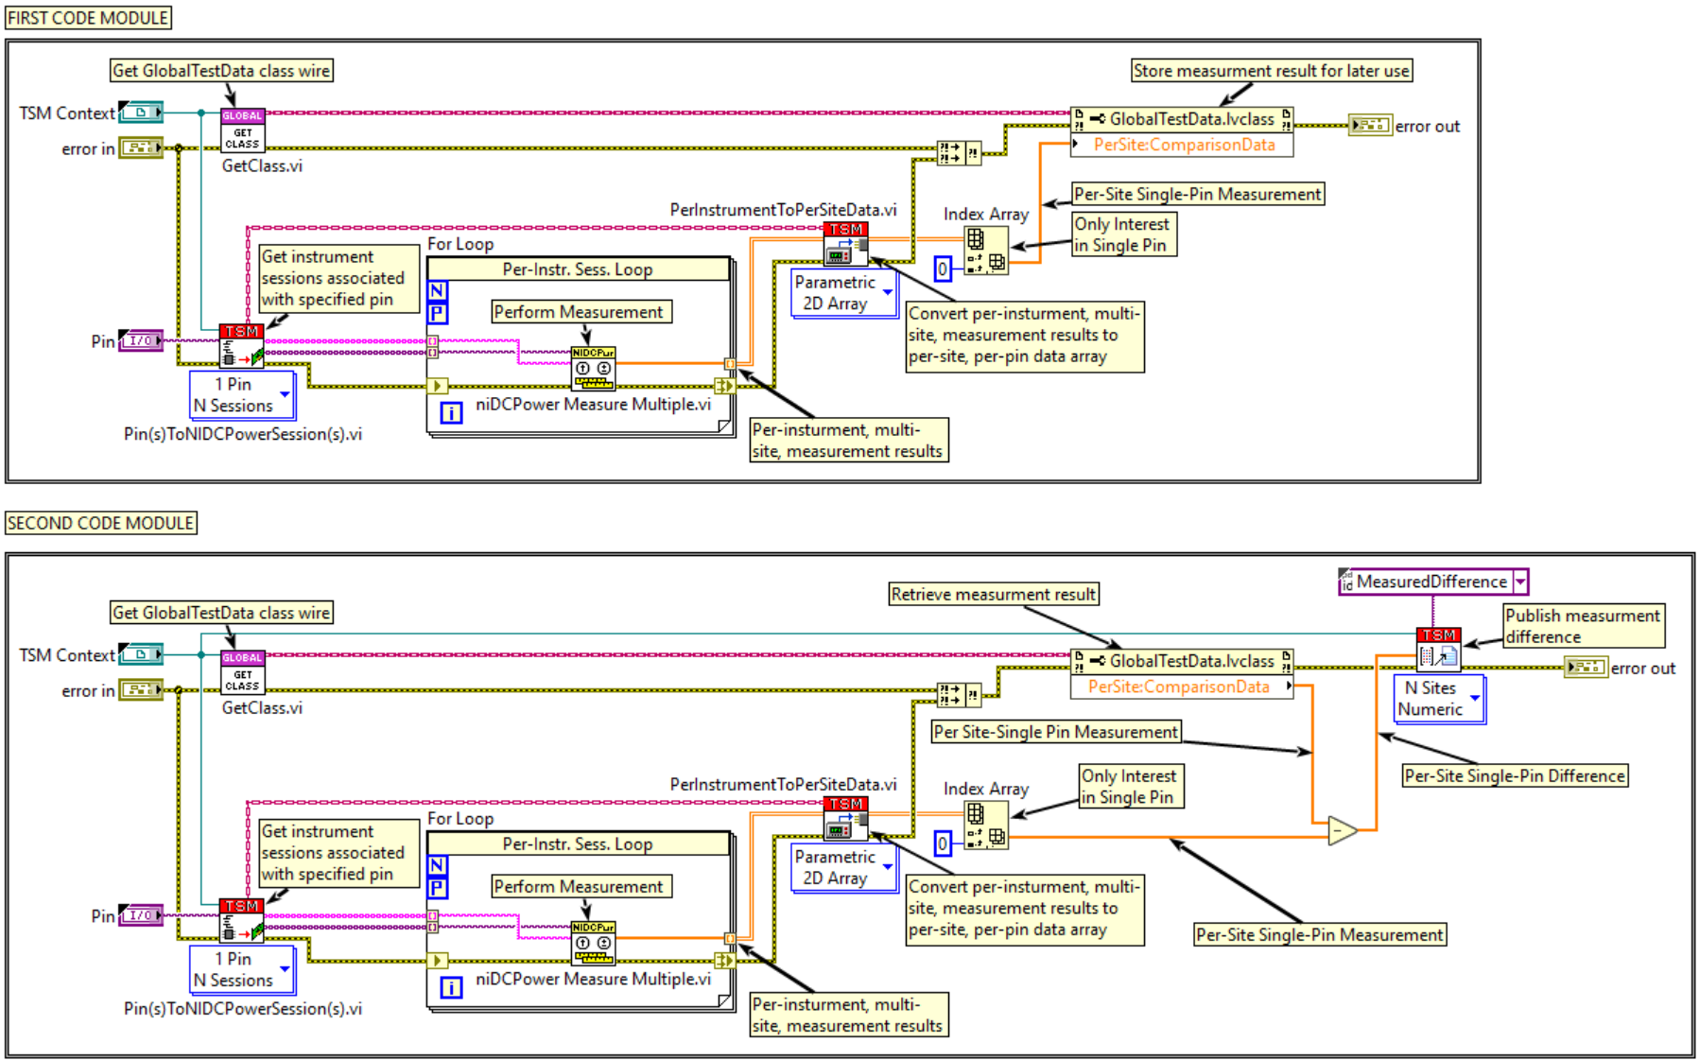
Example – Sharing Global Test Data Between Code Modules
STS Global Test Data Management
Notes:
Important Notes
Where is the actual data being stored?
Data is stored by reference in TSM’s memory space (dynamic memory within TSM’s .NET assembly), it is not actually being stored in LabVIEW’s memory space.
The class wire is essentially a wrapped reference to the TSM context, when you operate on a data item via property node the property node will call in the TSM context’s memory space to access the data item.
Although you are passing the data by value on the LabVIEW block diagram, the accessing of the data happens by reference… that is the reference to the TSM context.
Property Node elements are executed on sequentially, which means whichever order you read or write from, top-->down, would be the order in which the data would be manipulated.
This inherently prevents any race conditions within a certain VI if there is only ever one Property Node accessing the class at a given time.
Since the wire is passing around and operating on the data by reference behind the scenes, you should still incorporate data flow where possible to ensure two property nodes are not being used at the same time, where one can just as easily do the job. Avoid using branching the same Class wire to multiple Property Nodes unless you can ensure those Property Nodes are accessing unique data items. Otherwise, access all necessary data items for a particular part of your code module using one Property node at a time.
Lifetime of Get Class wire reference: Class wire inherently same context as the TSM context, and therefore this VI must be called in every test code module that intends to access a data item.
The intended use case for a given VI is to only ever need to call the “GetClass.vi" function once, to get the class wire and then use the class wire as a reference to access the data via property node and connect the wire to the next instance of property node which access the data.
Data Types: Data items can be of any LabVIEW type, including Enums & Type Definitions.
*If the data type you want to store is a type def, the .ctl file for the type def should exist within the ...\Code Module\Common\<TSM Context Data Access Class Name>\Public\Typedefs directory.

Slide 16
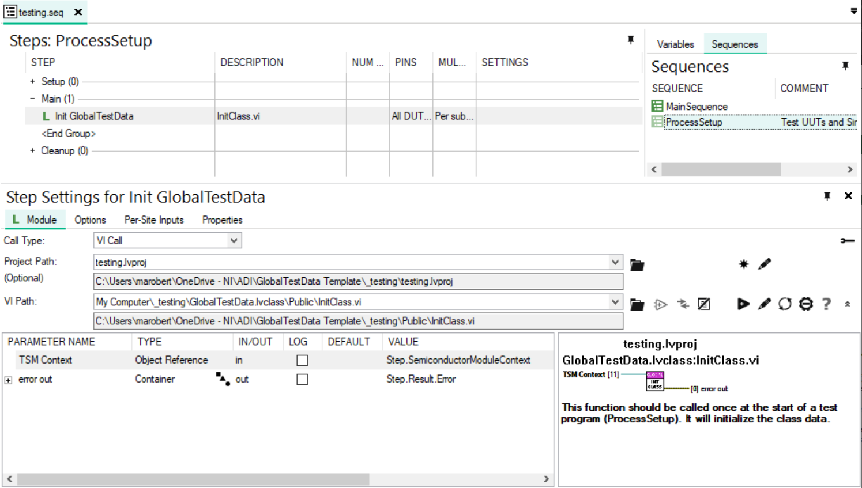
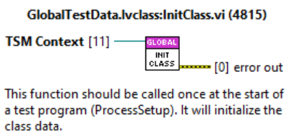
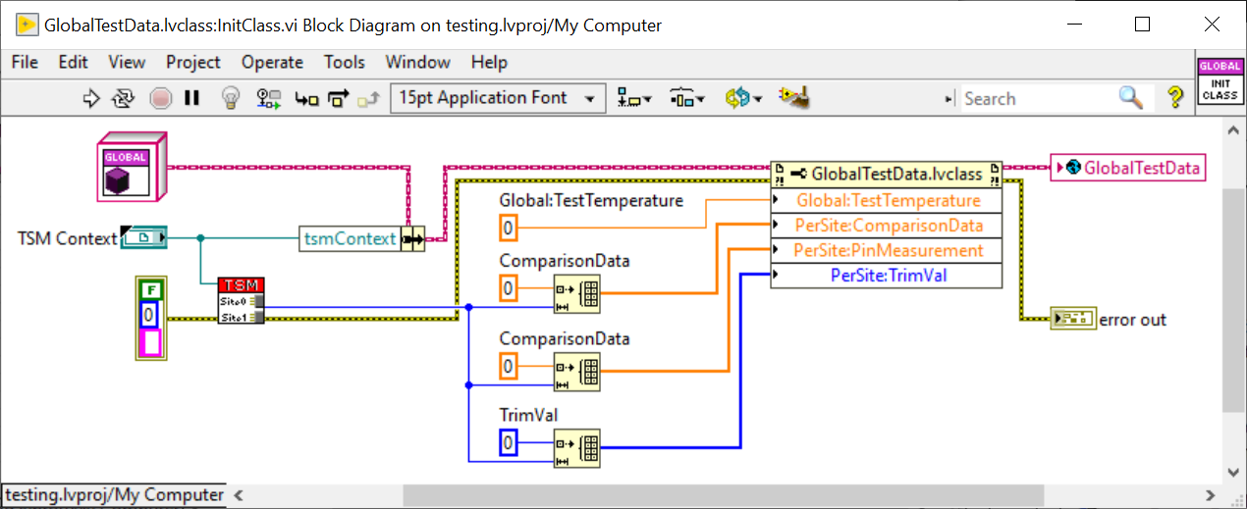
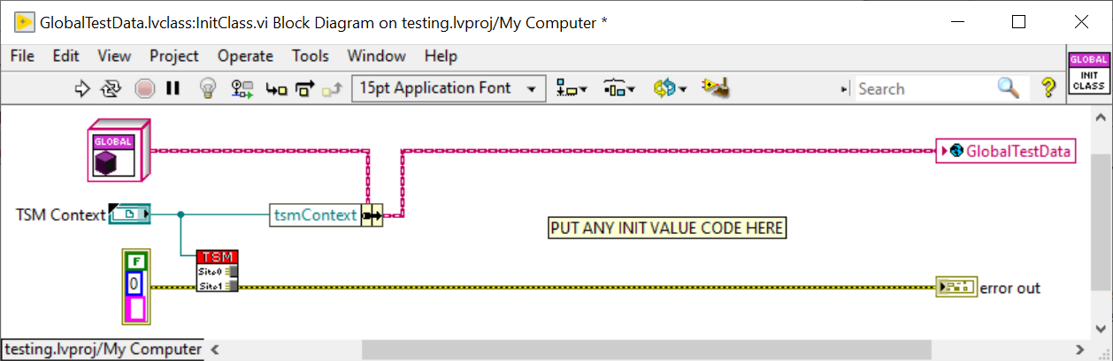
Workflow – Initializing Global Test Data in ProcessSetup
STS Global Test Data Management
The InitClass.vi in the GlobalTestData class must be called from TestStand in ProcessStep within the Test Program’s sequence file.
Inside this VI is where initial values of the Global Test Data properties should be defined and will be instantiated when a lot starts.

Slide 17
Taking this concept to the next level!
STS Global Test Data Management
This concept of class-based data encapsulation in LabVIEW can be used for other application specific class types in your Test Program, not just Global Test Data.
You may want to explore creating your own class template for an application specific class type, such a Fuse data.
Making Data Private & Adding Methods
Any property in the Class can be marked as private, meaning only a VI claimed by the class (i.e. a class method) can access on that data from a property node.
Data can further be encapsulated by making properties private and only accessing or acting on the data via the use of class methods.
While methods should not be added for the Global Test Data use case, the LabVIEW class can incorporate data specific methods to act on the data however you see fit.
Notes:
Add screenshot of generic example.

